Slide 1
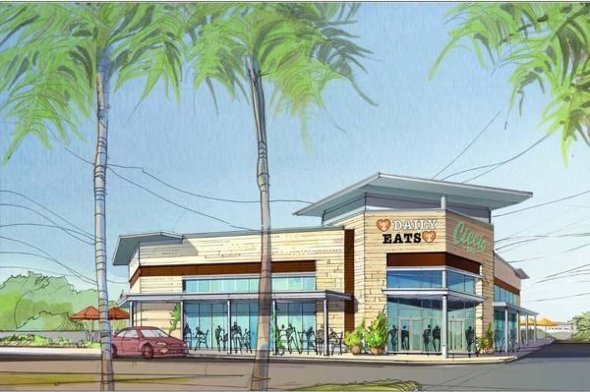
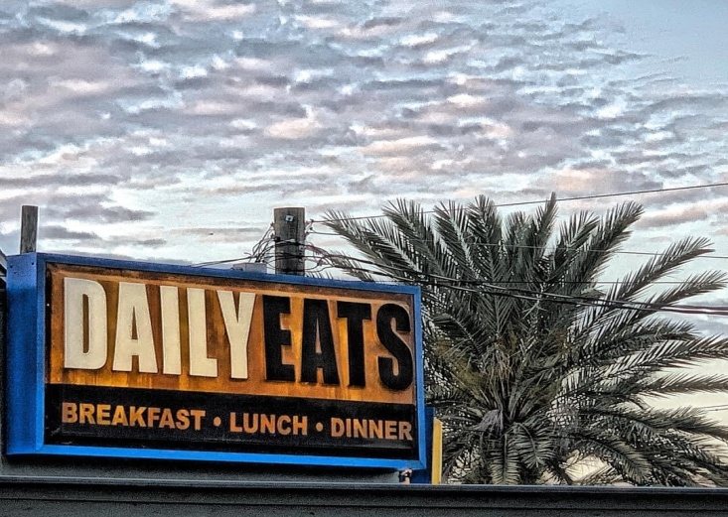
BPA FAMILY SPIRIT NIGHT! Please join us!
Daily Eats
901 S. Howard Ave.
Tampa, FL 33606
5:00-8:00 PM
Wednesday, April 28, 2021

